Slide 2
CRI-O
All the Runtime Kubernetes Needs
Mrunal Patel and Peter Hunt

Slide 3
Introduction
CRI-O
Container engine implementing Kubernetes Container Runtime Interface (CRI)
CRI-O
Supports all OCI compatible container images
Including all older Docker formatted images
Supports any container registry
Supports all OCI container runtimes
For e.g. runc, kata, gvisor

Slide 4
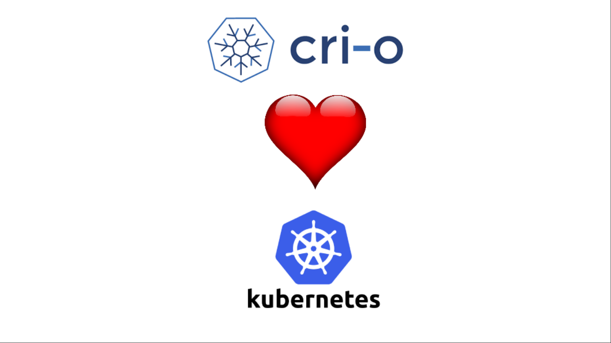
Why CRI-O
Only for Kubernetes
PRs pass 1500+ tests before being merged
CRI-O Version tied to Kubernetes.
CRI-O 1.16 works with Kubernetes 1.16
CRI-O 1.15 works with Kubernetes 1.15
“Make running containers in production secure and boring.”

Slide 5
Why CRI-O
Standard components
Uses containers/storage for managing COW filesystems for containers
Uses containers/image for pulling images from container registries
Uses CNI for networking: flannel, calico, weave, cilium
Supports any OCI runtime

Slide 6


Why CRI-O
Minimal Daemon

Slide 7
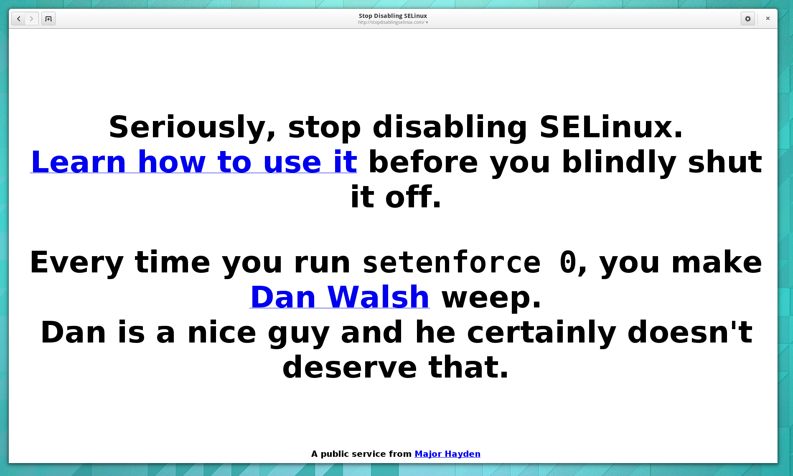
Why CRI-O
Security focused
Notes:
read only by default
supports kata for additional lockdown
selinux compatible
minimalistic seccomp profile

Slide 8
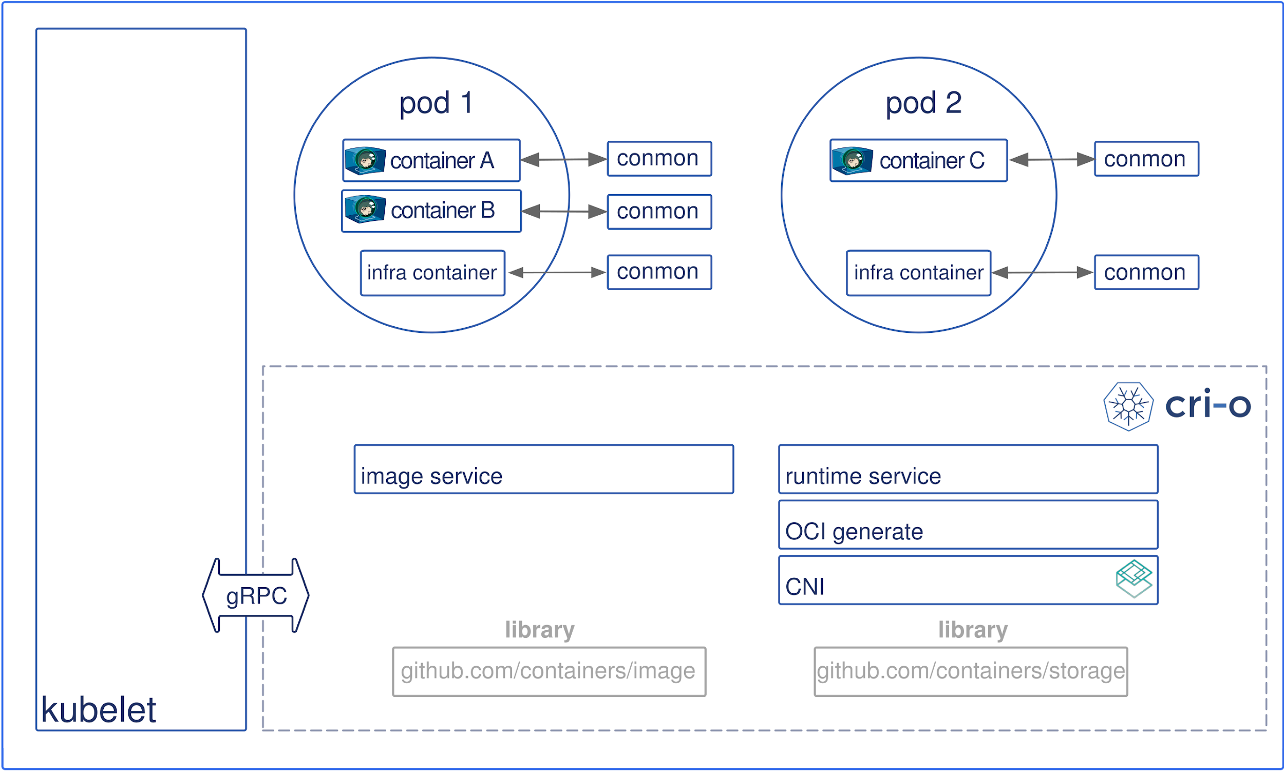
CRI-O Architecture

Slide 9

Demos
image source: https://ccsearch.creativecommons.org/photos/81a651ac-1091-457b-9fd2-783e09eab03f

Slide 10
Thank you!
Mrunal Patel and Peter Hunt

